Slide 1

Google Apps Training
Google Docs for Starters

Slide 2

Goals of this Training Session (Be Able To:)
Create a New (Google) Document
Work with Docs (Save, Rename, Copy, Delete, Export)
Edit Documents
Work with Templates
Upload Existing Documents
Use Revisions
Work with Collections
Share & Collaborate
Work specifically with the Student Growth Chart that Melissa shared with you

Slide 3

Google Docs Overview
Create Docs, Spreadsheets, Presentations, Forms, Drawings
Access Anywhere on Any Computer
Collaboration - Sharing Securely
KISS - 80/20 Rule
Upload any kind of file - Lots of Storage
Backed up, won't lose your stuff
Easy Search (This is Google, after all)
Notes:
Sending & Receiving messages
Working with Conversations
Labels & Archiving
Adding a signature
Formatting, fonts, and colors
Auto-complete
Selecting contacts while composing
Replying to messages
Forwarding messages
Saving drafts
Adding Attachments (20MB limit) & Forwarding attachments works
Filters

Slide 4

Nuts & Bolts
Create a New Doc
Basic Editing
Save, Save a Copy, Delete
Templates
Upload Existing Documents
Folders for Organizing
Spell Check & Dictionary
Sharing Docs & Collections [Video]
Revisions
Student Growth Chart

Slide 5
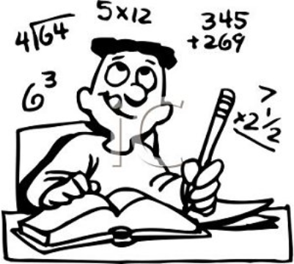
Assignment:
Pair up with a Buddy
Each create a new Doc
Type some text
Change formatting
Share Doc with Buddy
Edit shared Doc
Review Revisions

Slide 6
More Info:
http://docs.google.com/support
The Google Gooru
Google Docs Basics: Creating & Sharing
Google Docs Tutorial Videos
Google Docs Overview
Google Docs in the Classroom

